Slide 1
Frequent & Correlation Analysis
Isael Corona

Slide 2
Intro
Smart Contract: A digital contract stored on blockchain that are automatically executed when predetermined terms and conditions
To explain it in easier terms, a piggy bank with a set of special rules. This piggy bank can automatically follow instructions, like giving you a coin when you finish your chores or saving a certain amount of coins each month for a fun outing.
Unfortunately, Hackers try to find vulnerabilities in smart contracts to exploit currency
I will be showing you guys they types of attacks, what ways do hackers attack the most, see what type of combos happen during attacks and how we can prevent them.

Slide 3
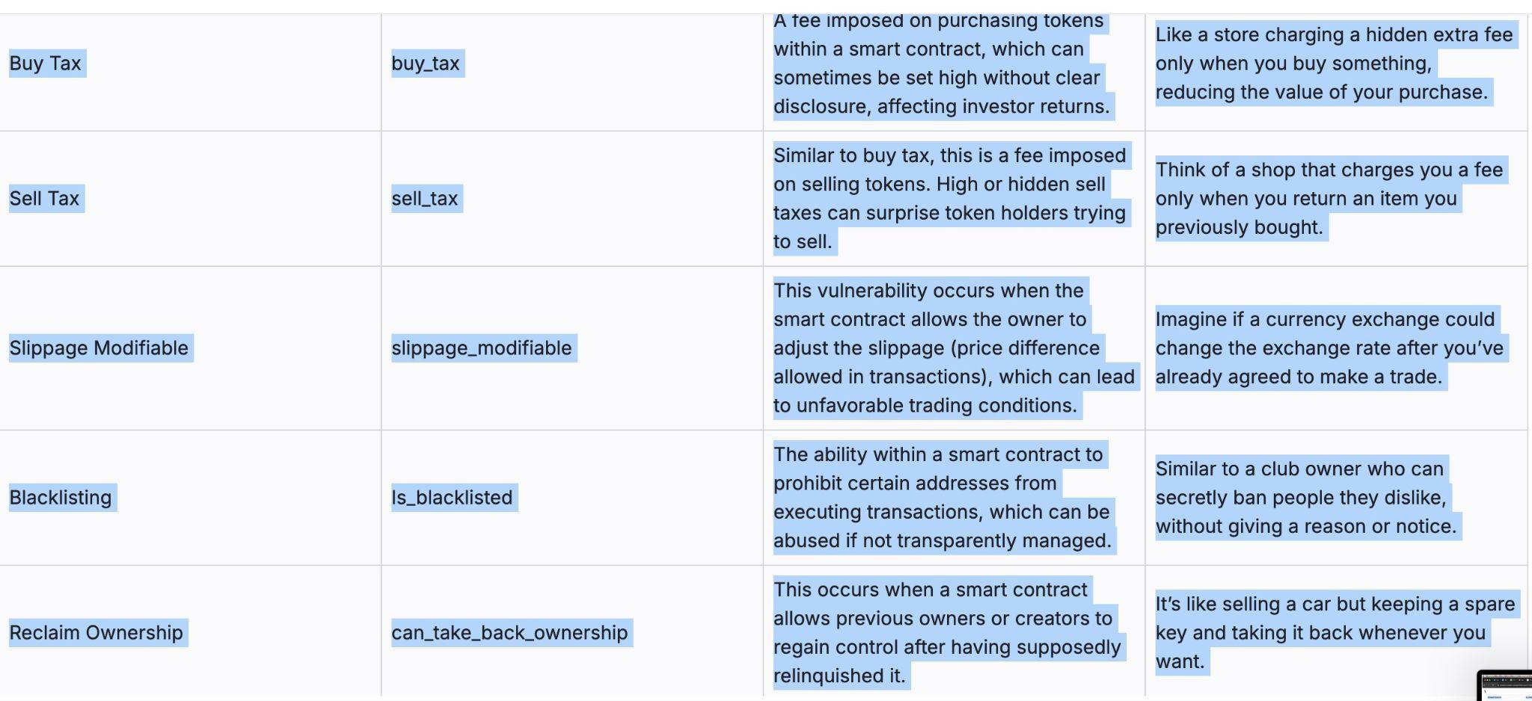
Risk Tags for Smart Contracts

Slide 4
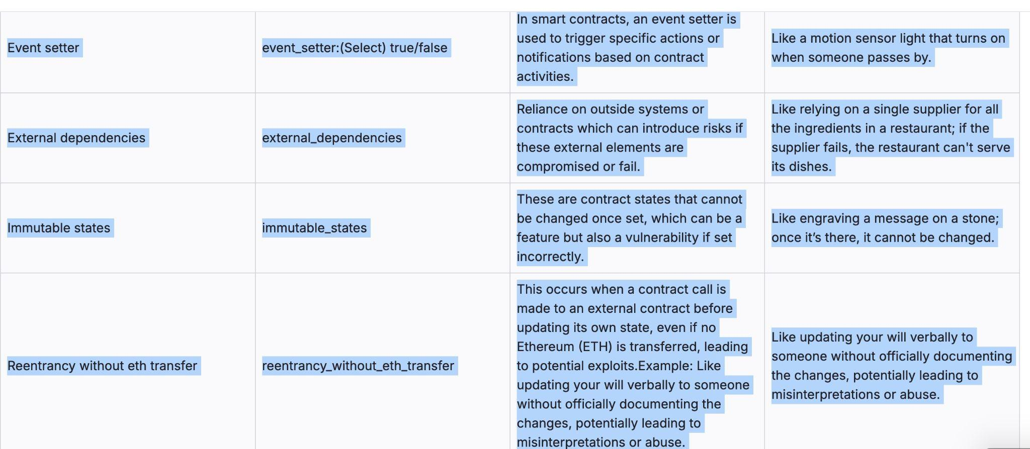

Slide 5
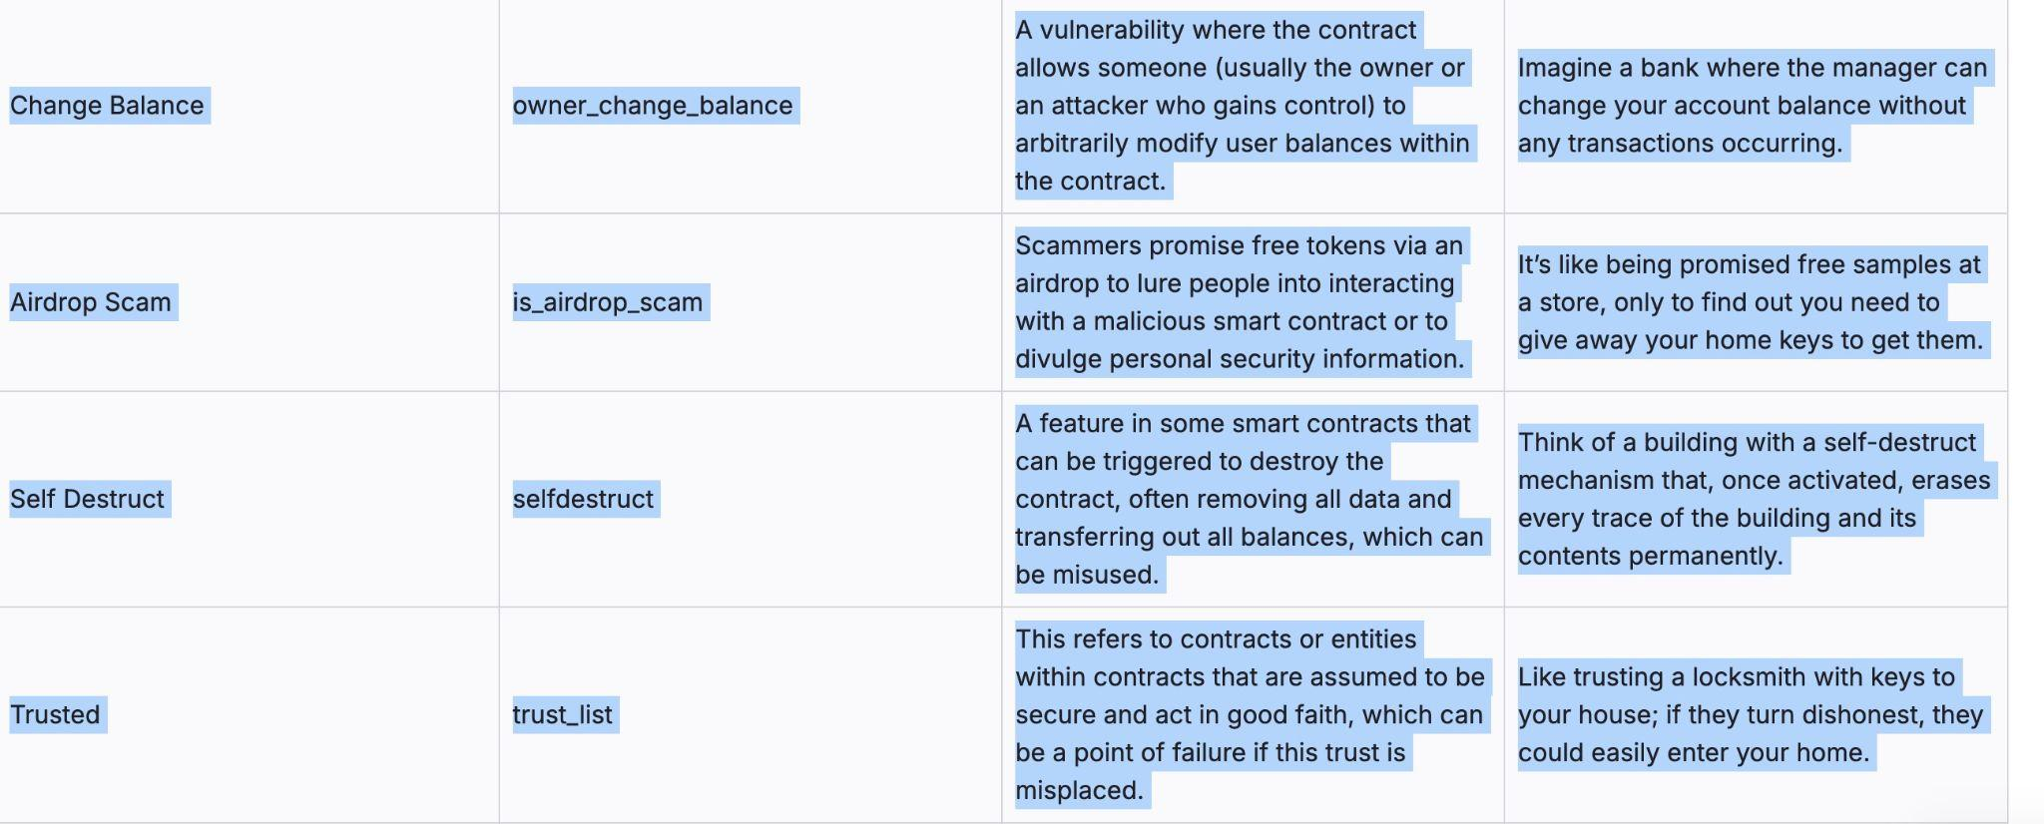

Slide 6
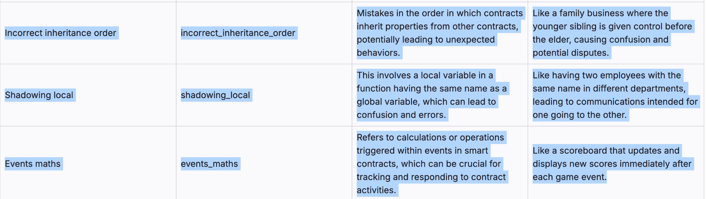

Slide 7
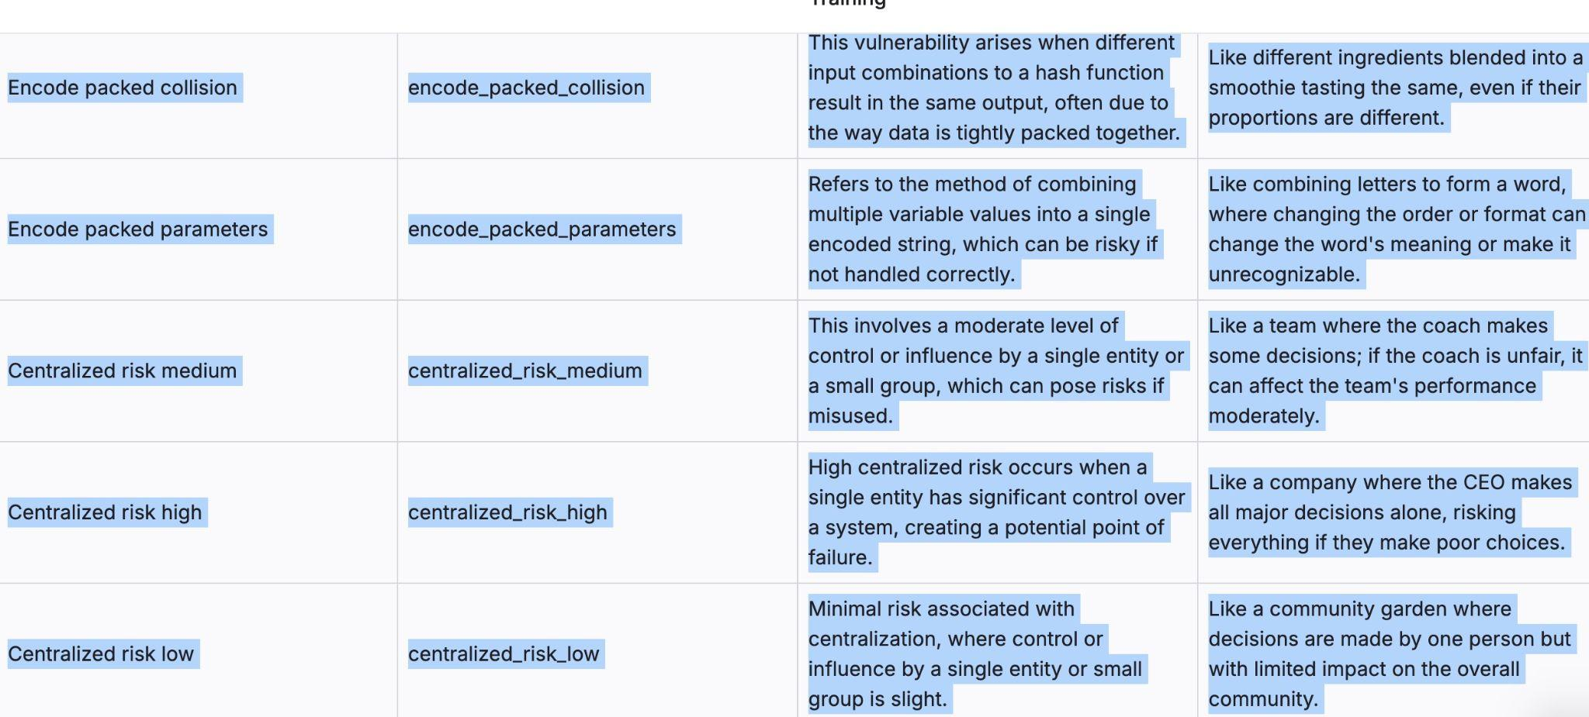
Risk Tags for smart contracts

Slide 8
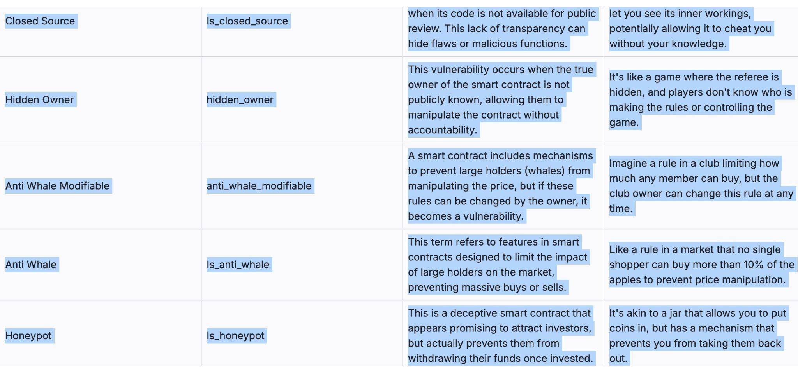
Risk Tags for smart contracts

Slide 9
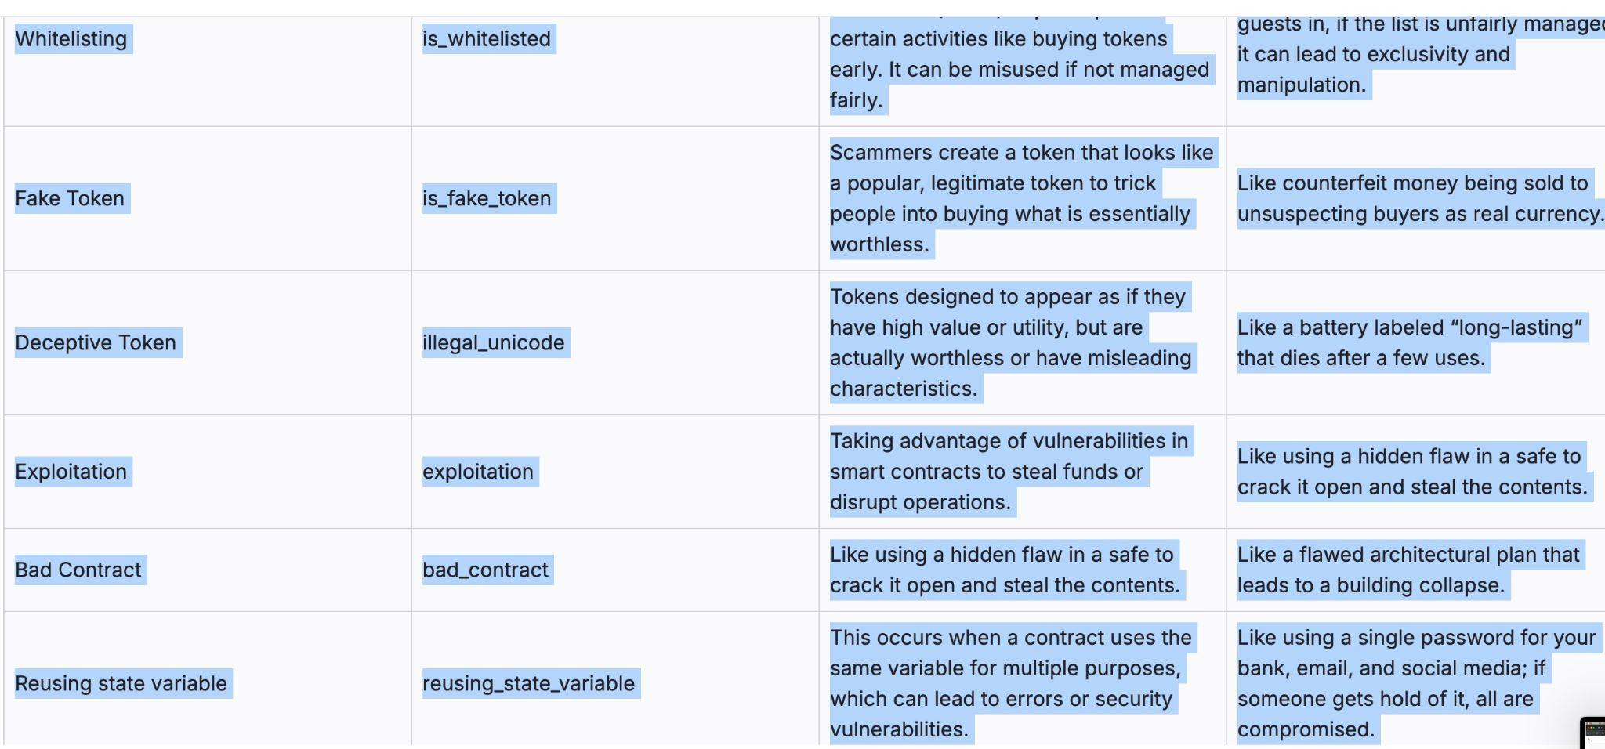
Risk Tags for smart contracts

Slide 10
Now time for a data visualization and some notes to follow up with

Slide 11
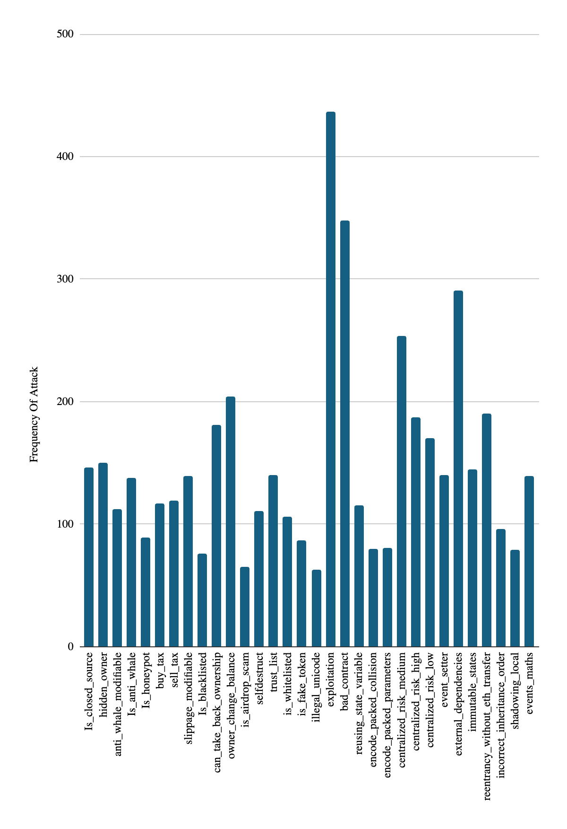

Slide 12
Frequency Analysis
Several risk tags come up more than others
The top 5 risk tags that come up the most are 1. Exploitation at 437 times 2. Bad Contract at 348 times 3. External Dependencies at 291 times 4. Centralized Risk Medium at 254 times 5. Owner Change Balance at 204 times.
The lower 5 tags that appear are 1. Reentry without eth transfer at 63 times 2. Is airdrop scam at 65 times 3. Is black listed at 76 times 4. Shadowing local at 79 5.Encode Packed Collision at 80 times

Slide 13
Frequency Analysis
For the next slide, I calculated the percentage of how much each risk tag would come up across all of the audits reported. First will be a data visualization and a summary
There was a total of 968 audits in my data sheet and 21 total tags

Slide 14
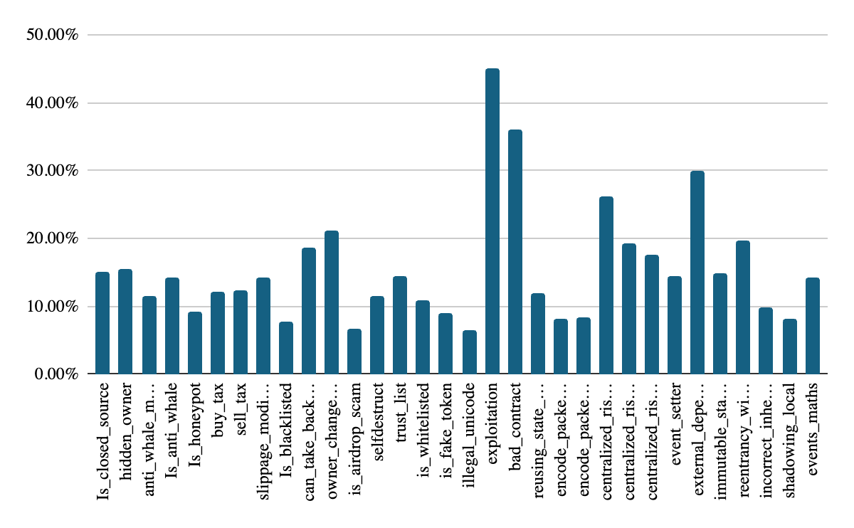

Slide 15
Frequency Analysis
The top 5 risk tags that come up the most are 1. Exploitation at 45.14% 2. Bad Contract at 35.99% 3. External Dependencies at 30.66% 4. Centralized Risk Medium at 26.27% 5. Owner Change Balance at 21.07%.
Exploitation and bad contract can be similar tags as they have overlap
The lower 5 tags that appear are 1. Reentry without eth transfer at 6.51% 2. Is airdrop scam at 6.71% 3. Is black listed at 7.85% 4. Shadowing local at 8.16% 5.Encode Packed Collision at 8.27%

Slide 16
Correlation Analysis
Now that we seen the frequencies of the risk tags, let's take a look at which risk tags have a correlation.
To analyze the correlation, I used a phi coefficient and heat map in python to show which tags have a correlation with each other.
To give context the range for correlation analysis ranges from -1 to 1
The closer the score is to 1 there will be a stronger correlation. Where as of it is close to -1 there is less of a correlation
If a correlation is 0 then two items are independent of each other and have no relation
In the following slide there will be a heat map then follow with analysis

Slide 17
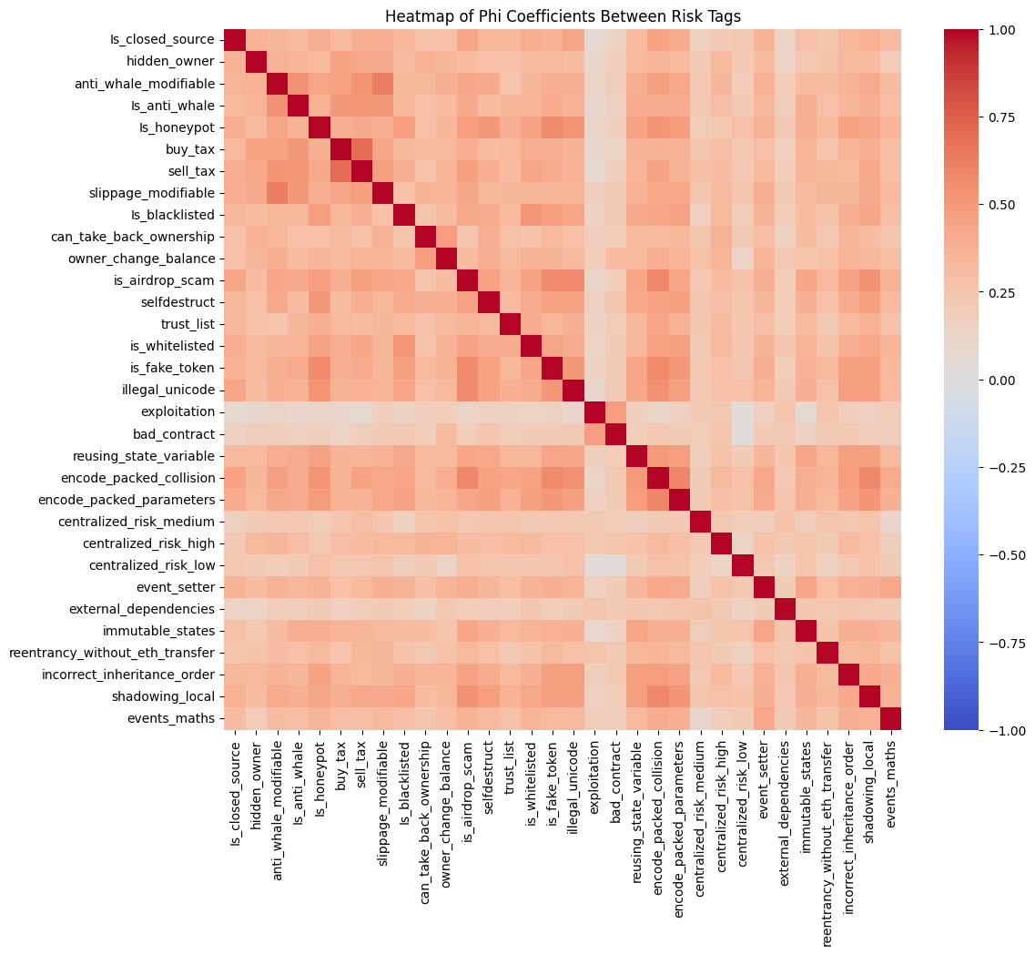
Heatmap of all correlations

Slide 18
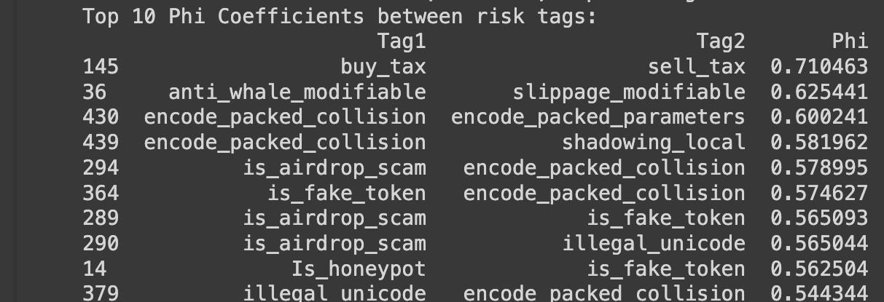
Top 10 Correlations

Slide 19
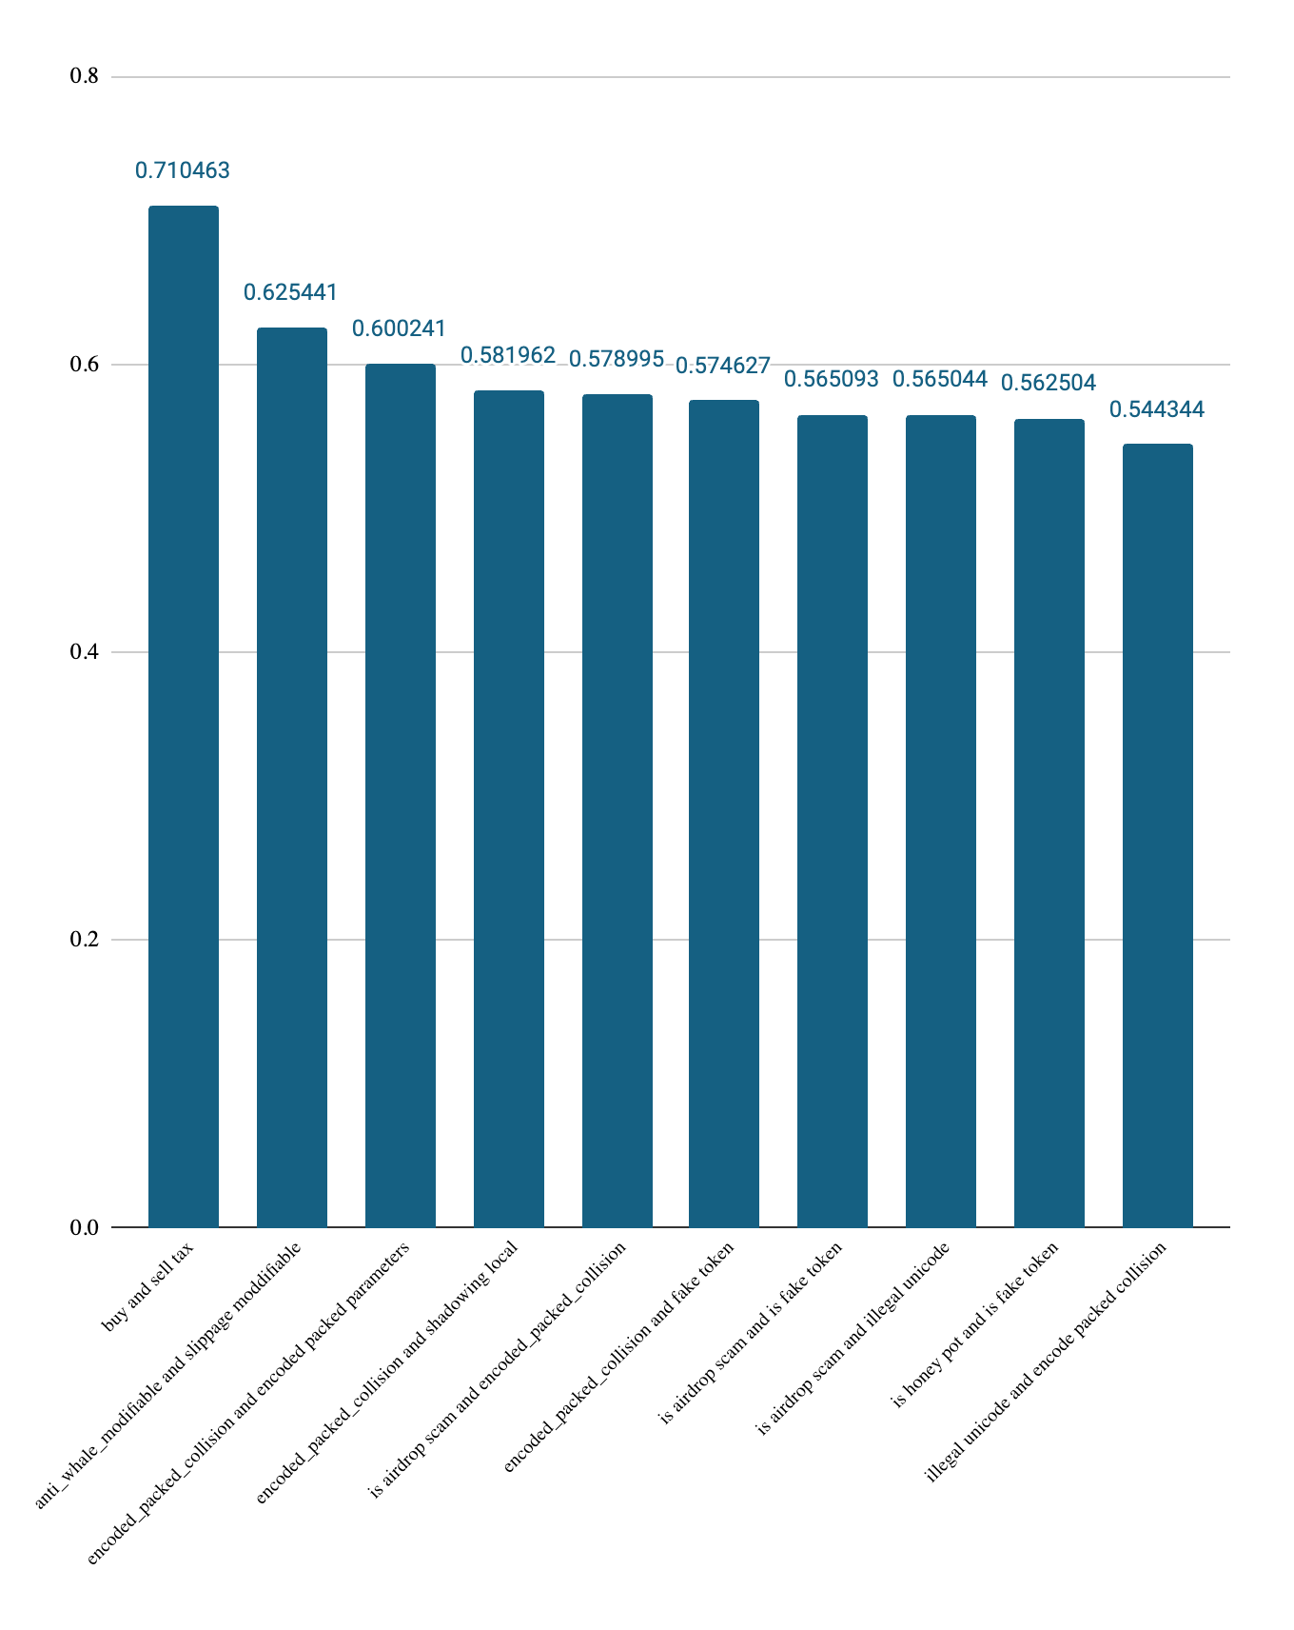
Top 10 but in a histogram

Slide 20
Correlations
The correlation closest to 1 is buy and sell tax at .710463
However the buy and sell tax tags only came out in the first place other tags came up in multiple positions of the top 10
For example, encode_packed_collision came out 5 times in the 2,3,4,5 and 10th place
Another risk tag that came up frequently was is_airdrop_scam appearing 3 times at the 4,6 and 7th place
Another risk that come 3 times was is_fake_token that appeared in the 6, 7 and 9th place

Slide 21
Summary
When it comes to risk tags the one that comes up the most is exploitation at 437 cases
When dealing with correlations the ones that come up the most is buy tax and sell tax having a phi coefficient of .710463 while encode packed collision, is airdrop scam, is fake token came up often in the top 10 in the correlations
Even though encode packed collision and airdrop scam are in the least amount of frequencies, they have a strong correlation with other air tags.

Slide 22
Recommendations
Smart contracts attacks might not go away but, we can prevent them!
I’d recommend the following to prevent several smart contract vulnerabilities and attacks
Implement Robust Testing Procedures
Perform functional tests to confirm the contract’s performance under various scenarios, ensuring security even in unusual conditions
Arrange for a third-party audit for an extra layer of security, as external auditors can catch risks that may go unnoticed in internal testing
Set up a bug bounty program to encourage the cybersecurity community to report any discovered vulnerabilities, continuously enhancing your contract’s security
Apply defensive programming by planning for possible errors to strengthen contract security

Slide 23
Thank you :)

